Slide 1
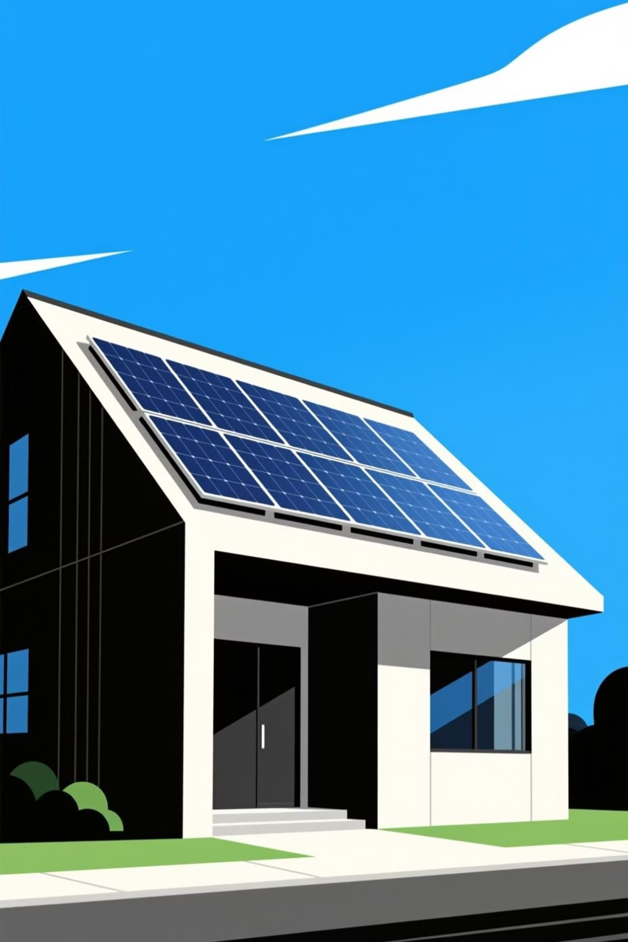

Fair Energy Pricing for Residential DERs
Presented by SolarCoders - Lucy Corthel, Arohi Patil, Siham Elmali, Nima J Sherpa, Aaron Padilla
November 23, 2025

Slide 2
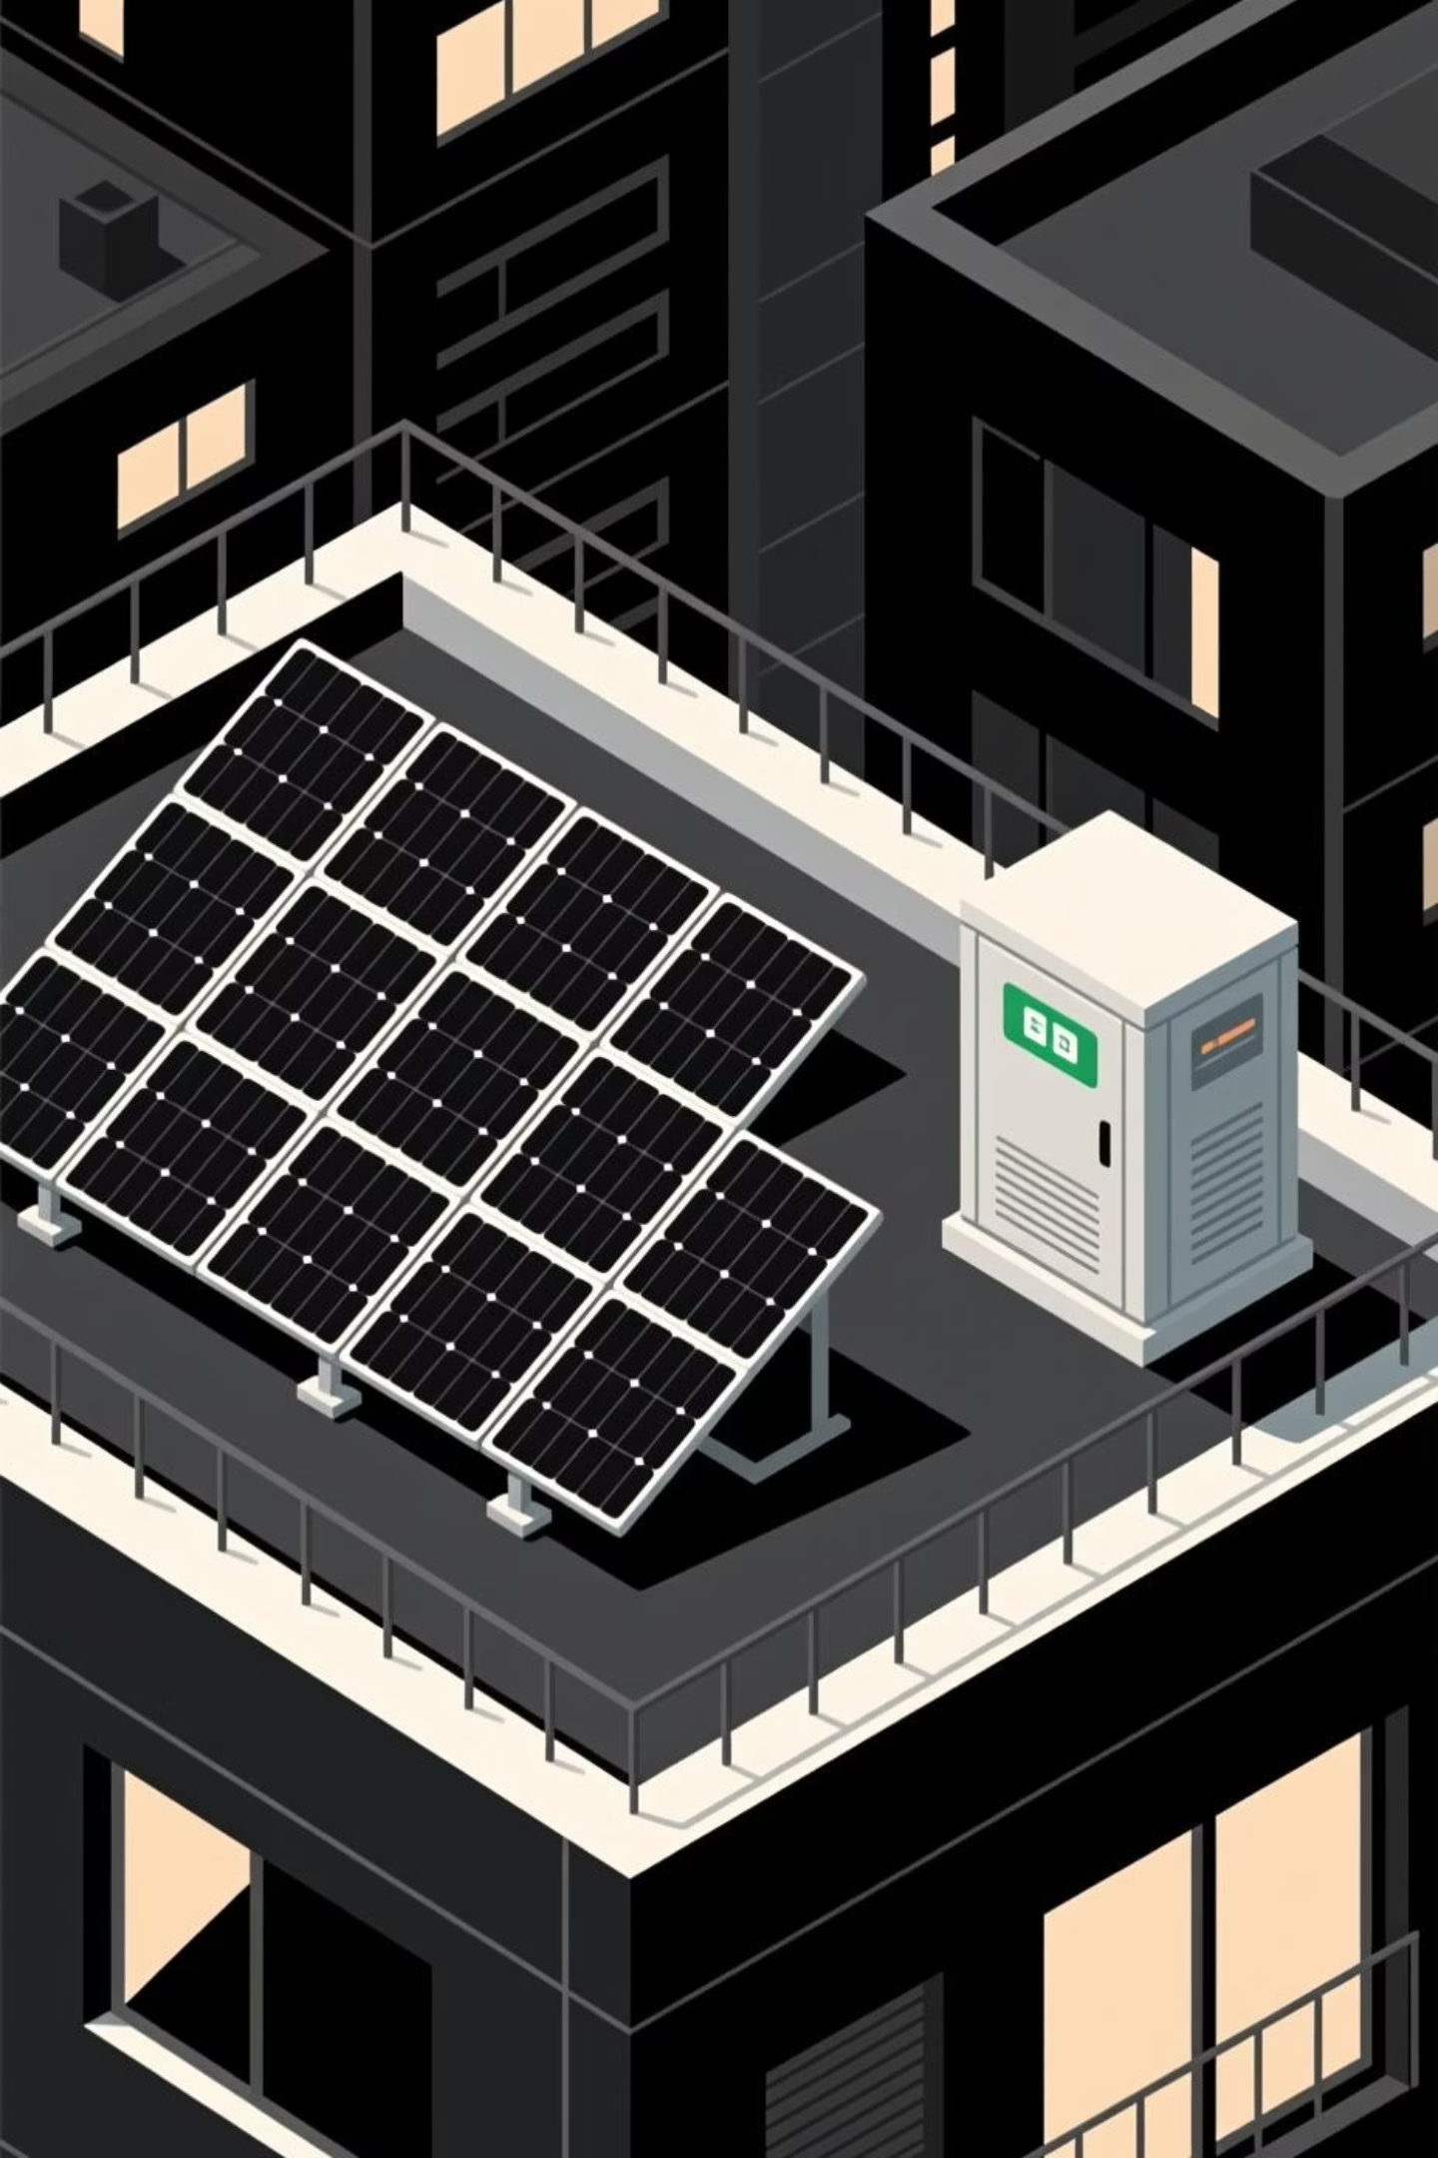
Executive Summary: Fair Energy Pricing Framework
The Ohio case of Harper and Jansto Family Trust vs. City of Bowling Green highlights the debate between utilities and consumers over rooftop solar and battery costs/benefits. We propose a Fair Energy Pricing Framework to incentivize Distributed Energy Resources (DERs).
Encourage Clean Energy
Ensure Cost Recovery
Promote efficient energy development.
Utilities recover grid infrastructure costs.
Diverse Energy Mix
Balanced Pricing
Ensure resilient energy systems with more power sources
Implement fair compensation structures for DER and non-DER consumers.

Slide 3
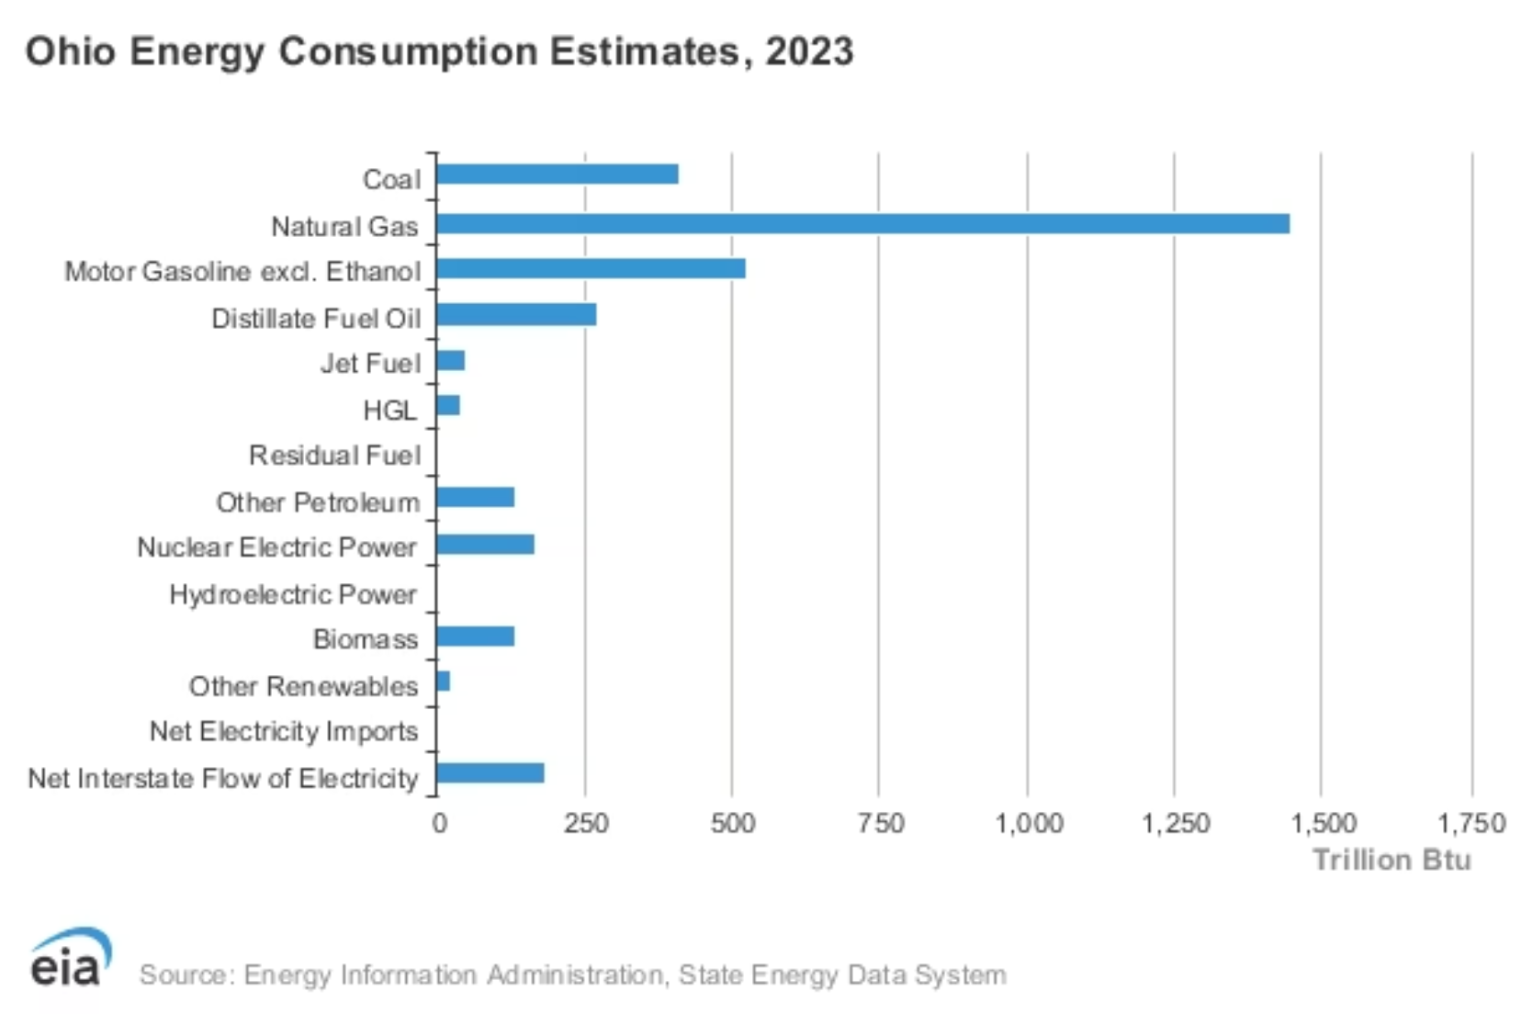
Context: The Need for an Updated Framework
Bowling Green's "Rider-E" charge (July 2020) adds $4/month per kWh PV installed, penalizing solar households and limiting economic feasibility. This charge aims to recover utility costs but lacks transparency regarding its use (e.g., Prairie State coal plant).
Valuing the benefits of Rooftop Solar
Reduces reliance on gas-fired peaker plants.
Lowers greenhouse gas emissions and air pollutants.
Eases grid strain during high demand.
Modern inverters provide valuable grid services.
Figure 1: 2023 Ohio energy mix shows high usage of dirty energy like coal and natural gas.
A successful model must ensure fair cost sharing for grid investment and maintenance. Communities need a voice in energy decisions, paired with predictable grid-cost contributions and strong DER incentives.

Slide 4

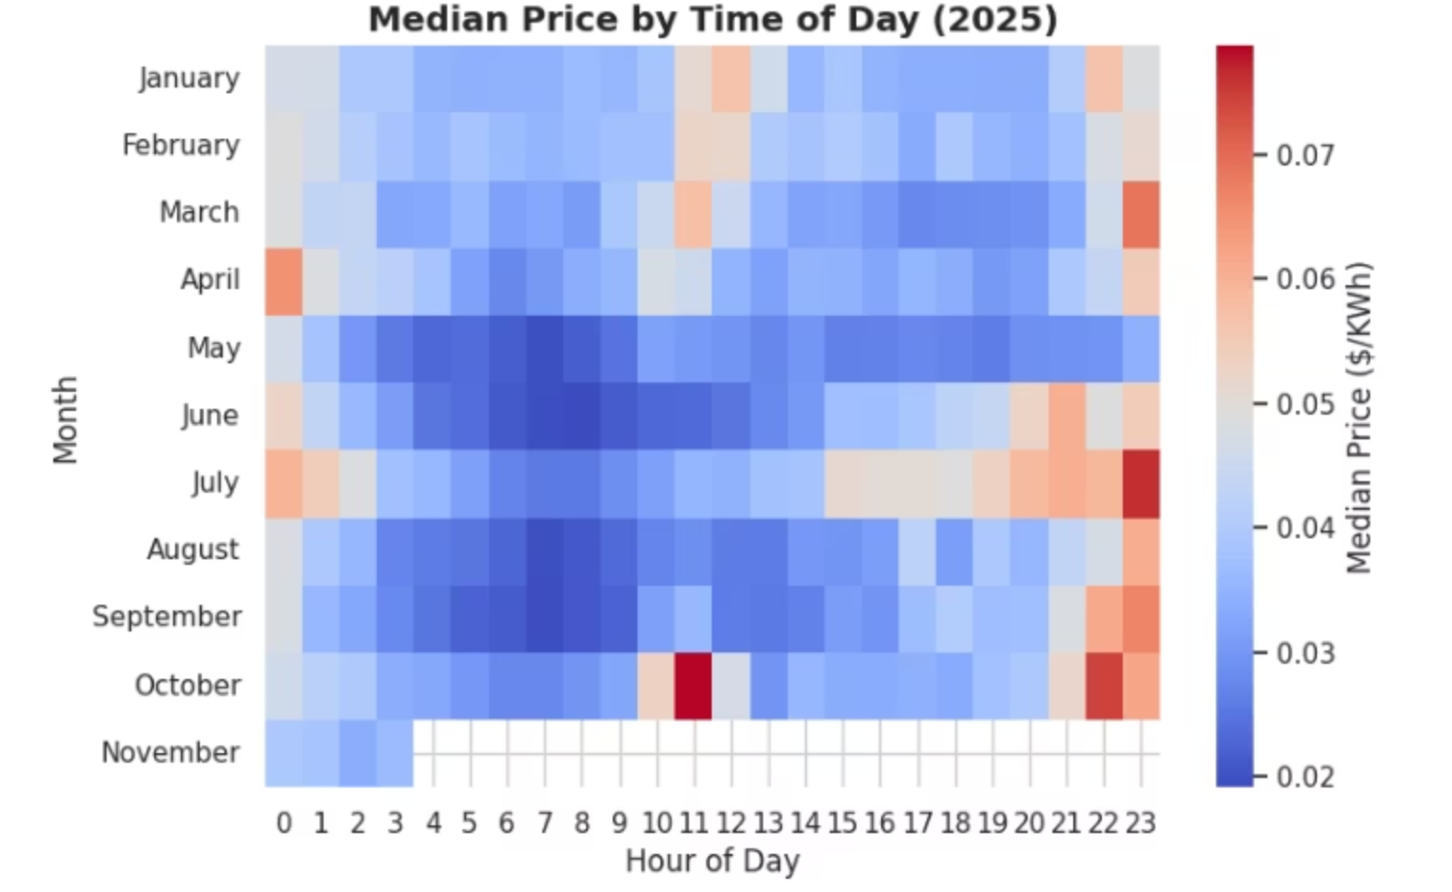

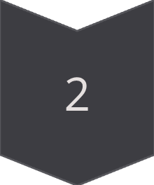
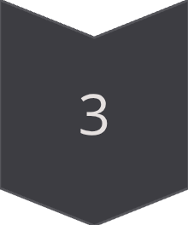
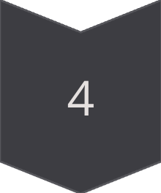
Recommendation 1: Robust Compensation Framework
We recommend developing a Fair Energy Pricing Framework to support DER and energy storage installations in Bowling Green. Accordingly, this might serve as a suitable resolution to the The State of Ohio, ex rel. The Harper and Jansto Family Trust vs. The City of Bowling Green case This framework will consider:
Fixed-Cost Recovery:
"How fast can users make back their money to build solar infrastructure"
Peak Demand Rate Changes
Incentive Structures
Energy Resiliency
Figure 2: Ohio energy prices are most expensive in mid-June and July at the end of the day.

Slide 5
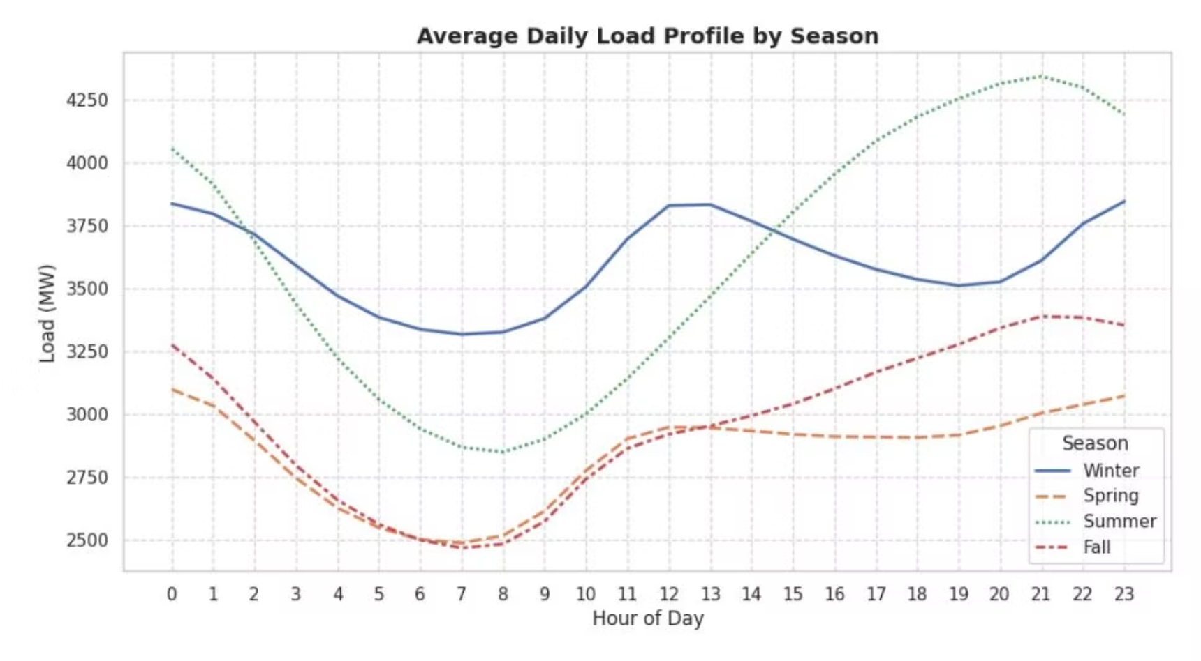
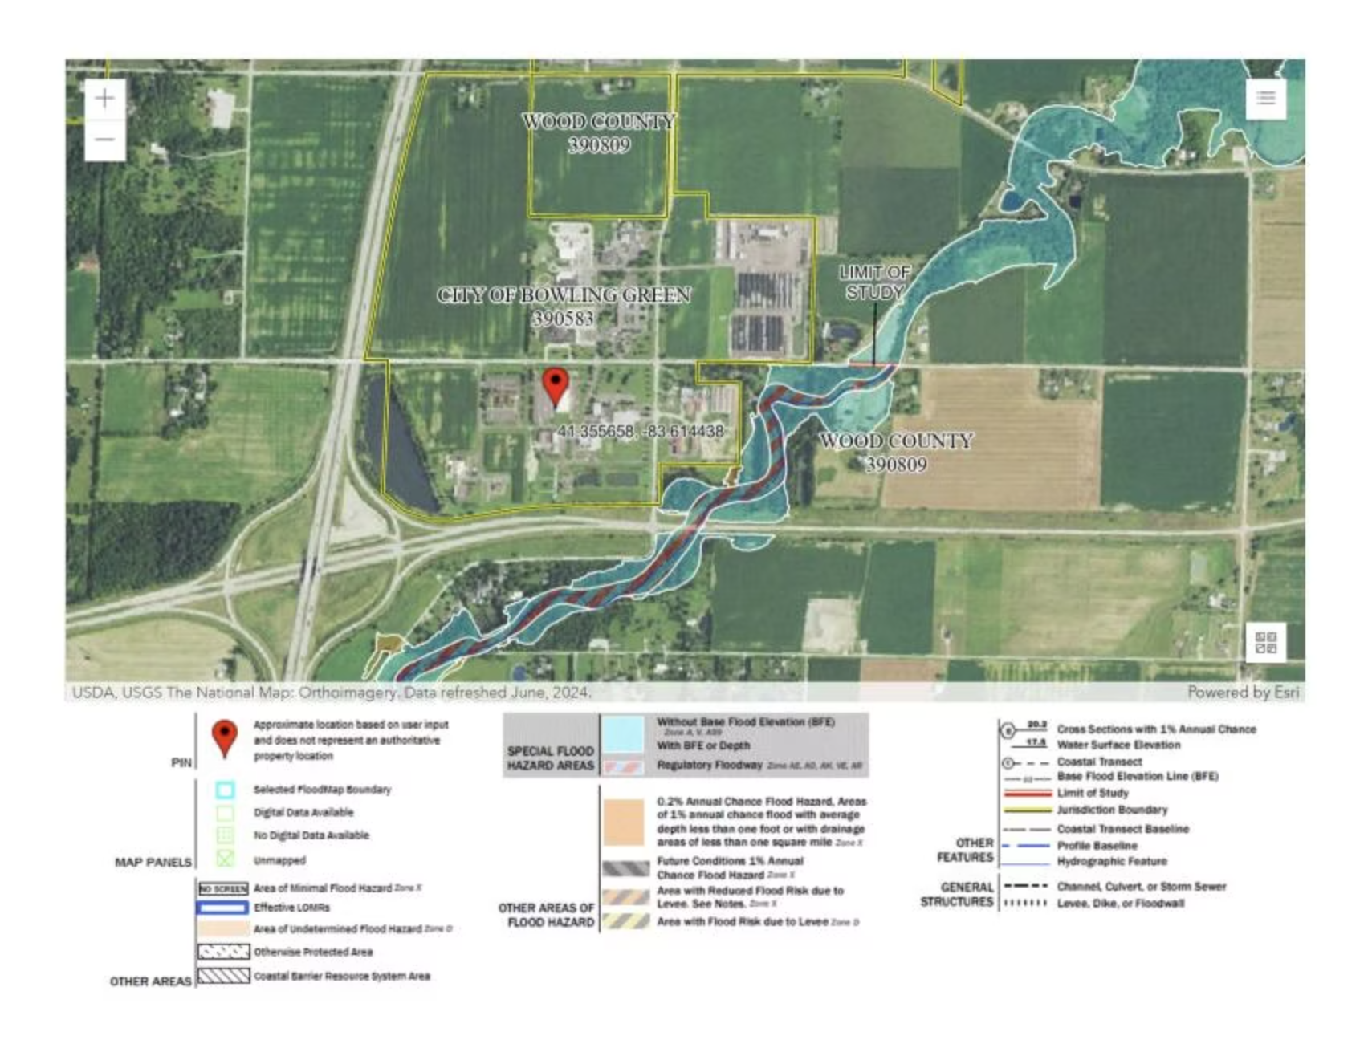
DERs for Grid Stability and Resilience
Solar with energy storage stabilizes the grid during hot months when AC usage spikes. Incentivizing solar and batteries in Ohio reduces grid strain and lowers prices for everyone.
DERs contribute to grid stability during extreme weather events, like the increasing Billion-Dollar Disaster Events in Ohio due to climate change. They also offer significant environmental and public health benefits through reduced emissions and air pollution.
Figure 3: Ohio's grid is stressed by summer afternoon/evening peak loads.
Figure 4: Bowling Green, Ohio faces high flood risk.

Slide 6
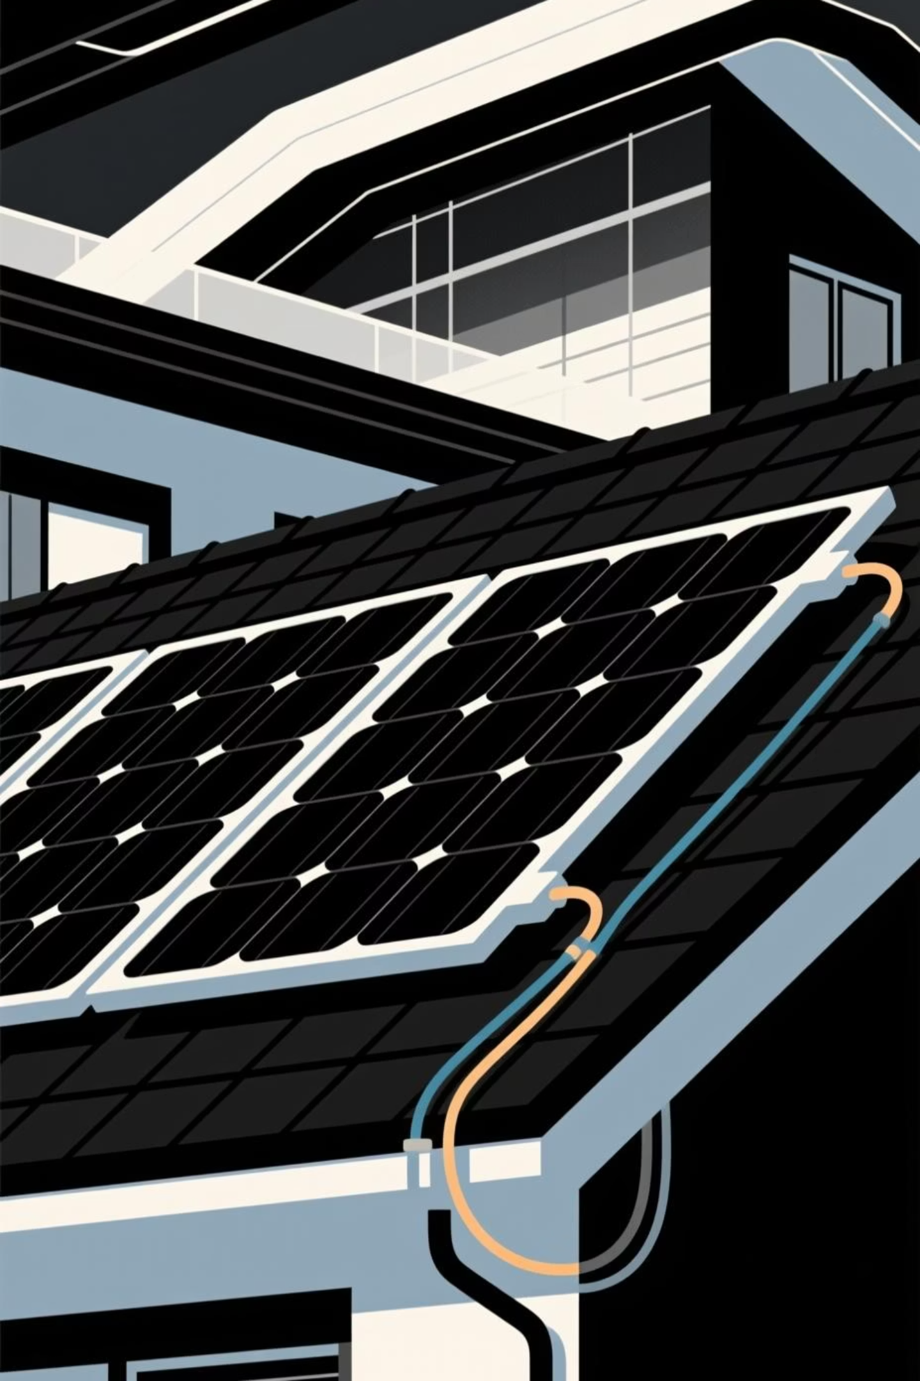
Recommendation 2: Addressing Rider E Charge
We propose an alternative framework for Bowling Green to ensure fair compensation for DER consumers. This section compares two scenarios for homeowner payback periods on DER investments over 25 years.
Ohio Case Study
Household installed 13.95 kW rooftop solar PV with battery storage in 2019-2020 for $37,000.
Current Rates
Market rate: $0.13/kWh for electricity delivered. Compensation rate: $0.075/kWh for exported solar generation.

Slide 7

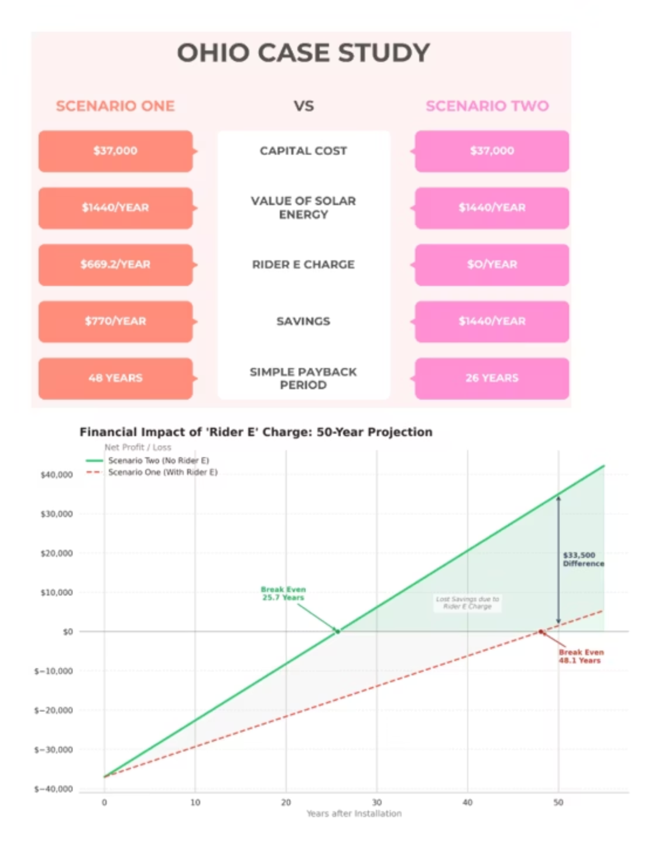
Scenario Analysis: Payback Periods
Scenario 1: Current Payback with Rider E
Scenario 2: Proposed Solution (Waiver of Rider E & Incentives)
Rider E (2020) mandated escalating fees, reaching $4/kWh in 2024. This results in a $56 monthly charge for the residential consumer, leading to a payback period of approximately 48 years.
This scenario removes Rider E charges and introduces incentives:
Time-varying export rate: 15¢/kWh during peak (top 5% demand hours), 7.5¢/kWh off-peak.
State-funded Ohio program: 30% subsidy, plus 10% for low-income communities.
Assumes 80% depth-of-discharge for residential storage during peak events.
Figure 5 (top): Waiver of Rider E cuts payback period almost in half.
Figure 6 (bottom): Financial impact of Rider E on residential rooftop solar feasibility.

Slide 8

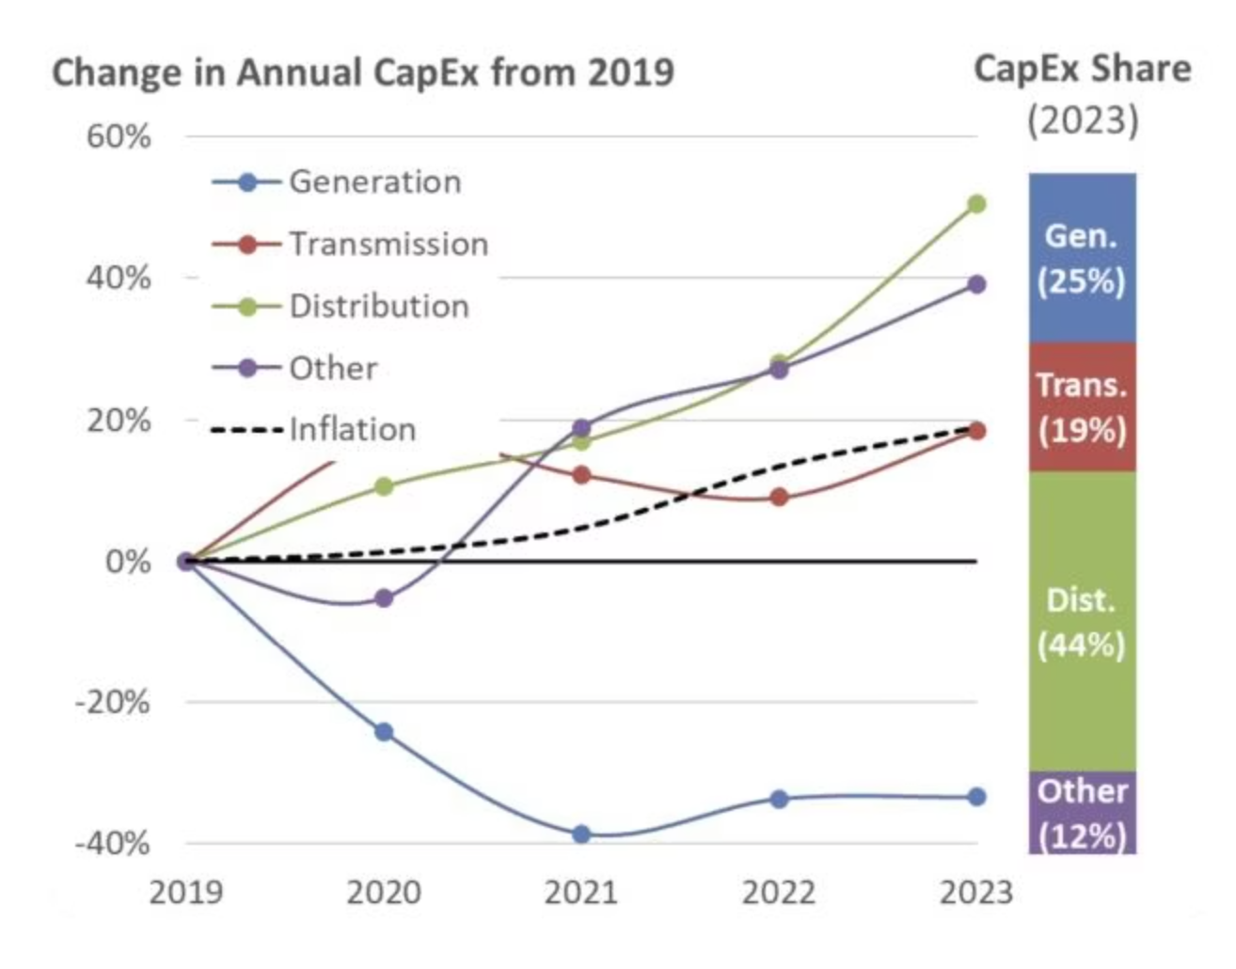

Recommendation 3: Holistic Approach for DER Adoption
Accelerating DER adoption can defer costly distribution infrastructure upgrades. Policymakers should address information asymmetry, ensuring consumers understand electricity rates for both DER and non-DER users.
Figure 7: Distribution costs represent the largest and growing portion of total utility costs.
Utilities are spending the most on local grid upgrades, represented by the increasing green distribution line.

Slide 9
Technical Appendix: Fair Energy Pricing Framework
The Fair Energy Pricing Framework considers key metrics for residential consumers with and without DERs:
Metric
Without Fair Pricing Framework
With Fair Pricing Framework
Initial Investment
$37,000
$37,000
System Size
13.95 kW
13.95 kW
Rider E Charge
$4/kW installed ($56/month)
None
Market Rate
$0.13/kWh
$0.13/kWh
Export Compensation
$0.075/kWh
Peak: $0.15/kWh, Off-peak: $0.075/kWh
State Subsidy
N/A
30% (plus 10% for low-income)
Battery Depth-of-Discharge
N/A
80% during peak events
Payback Period
~48 years
~26 years

